Slide 9
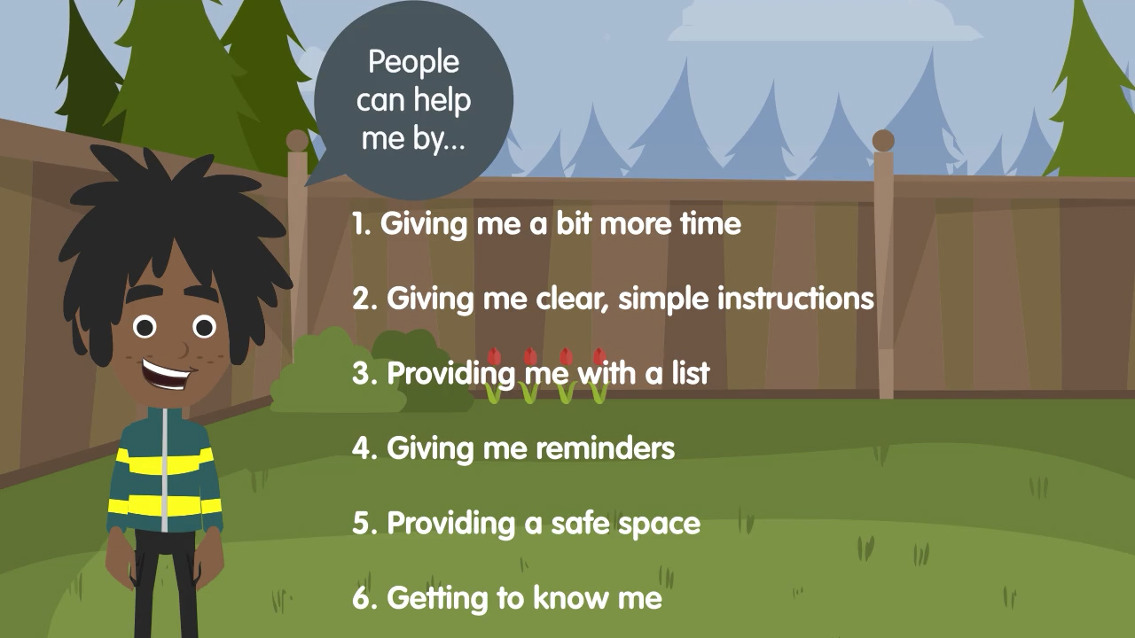

Slide 12
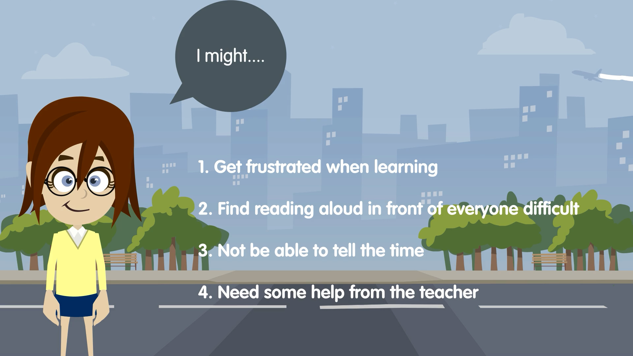

Slide 20
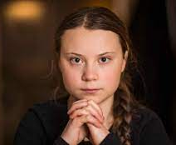
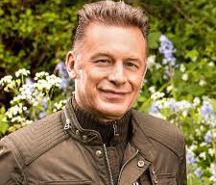
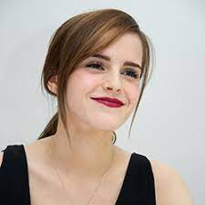
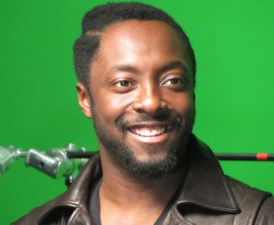
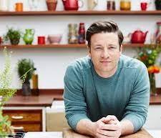
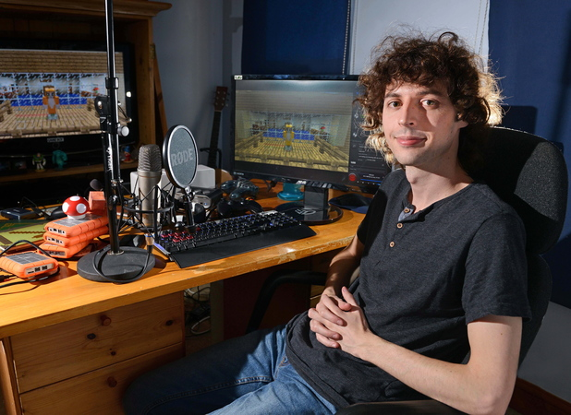
Famous faces who are neurodiverse
Greta Thunberg
Activist
- Autism
Chris Packham
TV Presenter
- Autism
Emma Watson
Actress
- ADHD
will.i.am
Musician/TV presenter
- ADHD
Jamie Oliver
Chef/TV Presenter
- Dyslexia
Stampy Long Nose
YouTuber
- Dyslexia

